Slide 1
Group 11: Final Project
Katherine Ringgenberg, Ryan Connolly, Megan Miller
Nathan Carter, Kyung-Tae Kim, and Jisoo Han

Slide 2
Introduction

Slide 3
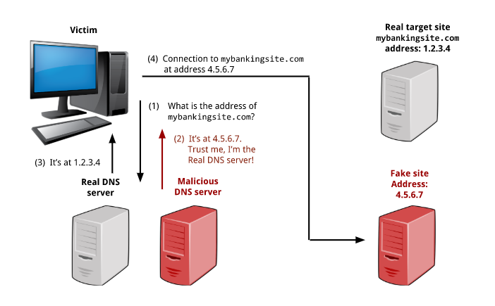
Redirect Traffic To Fake Site
Redirect traffic to a wrong or fake site with DNS spoofing on a LAN
DNS Server translates human readable urls (ex: google.com) into an IP
Big Idea
Fool victim into thinking they are communicating with DNS Server
Send victim false information when they request the website
Direct them to somewhere dangerous instead (ex: where attacker can intercept credentials)

Slide 4
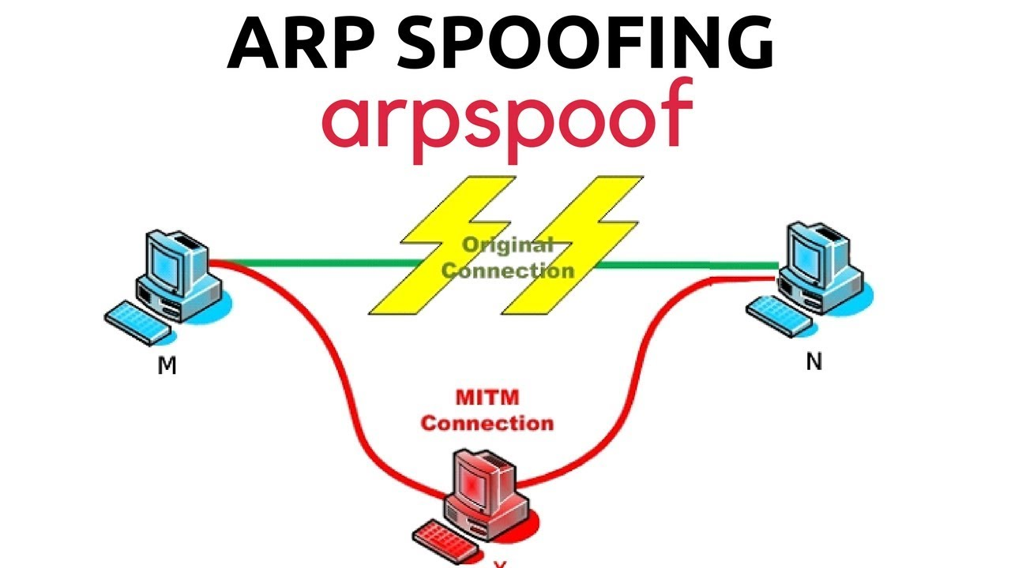
ARP Spoofing
ARP stands for Address Resolution Protocol
This is used to link the MAC address to an IP address
Can be used in man in the middle attacks
ARP spoofing:
Tell client that you are server
And or tell server that you are the client
Now all communication with website will flow through the attackers computer

Slide 5
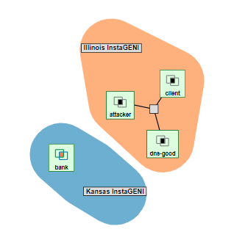
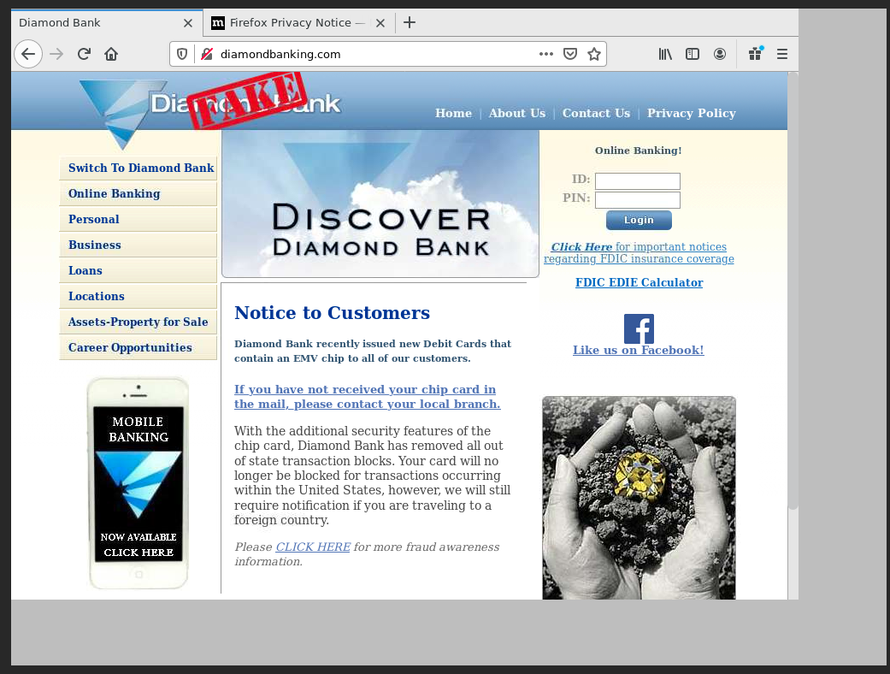
Our Attack
We setup a ARP spoofed man in the middle attack
Make client think it’s talking to dns-good, instead of attacker
Make dns-good think it’s talking to client, instead of attacker
Dnsspoof real website with fake website created by attacker
Pass the request to dns-good still
Key is the attacker has to send back to the client before dns-good

Slide 6
Demo

Slide 7
How to detect and defend against attack

Slide 8



Using Command Line/Terminal
Check ARP Tables on your computer
This can be done using the arp command in Linux/Windows
Ex: arp -a -i eth1, arp -1 (windows)
Use tools from the internet (WireShark, XArp, etc.)
Analyze packets to detect ARP spoofing

Slide 9
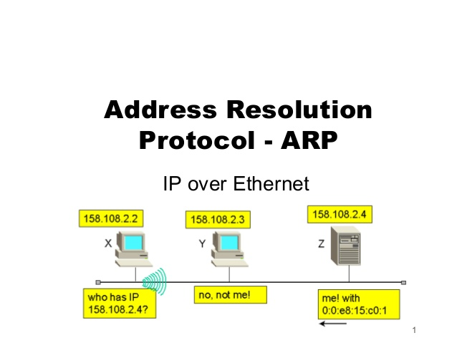

Prevention Methods
Map each machine on a network on each computer
Can disregard ARP replies since IP and MAC address will already be known for each computer on network
The tools on the internet can also be used for prevention (WireShark, XArp, etc.)
Use encryption when communicating with server

Slide 10
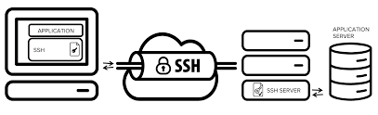
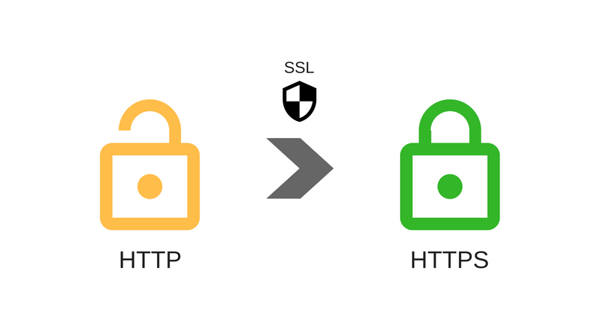

Encryption Forms
SSH
Create the secure tunnel with the server
Encrypt the data that is being passed to the server the tunnel
HTTPS
Authentication of website is verified
Encrypted HTTP data is transferred over a secure connection (Transport Layer Security or Secure Sockets Layer)
VPN
Transfer encrypted data to VPN server to do request
Bypasses the ARP spoof attack

Slide 11
Questions?

Slide 12
Sources
https://doubleoctopus.com/security-wiki/threats-and-tools/address-resolution-protocol-poisoning/
https://witestlab.poly.edu/blog/redirect-traffic-to-a-wrong-or-fake-site-with-dns-spoofing-on-a-lan/
https://www.veracode.com/security/arp-spoofing
https://www.iplocation.net/arp-spoofing
https://www.comparitech.com/blog/vpn-privacy/arp-poisoning-spoofing-detect-prevent/
https://www.ionos.com/digitalguide/server/security/arp-spoofing-attacks-from-the-internal-network/

